Slide 1


Handan YARICI
Senıor Software Engıneer
linkedin.com/in/handanyarici
github.com/handanyarici

Slide 2
SOFTWARE DEVELOPMENT STEPS
Problem Definition
Understanding the problem and requirements
Analysis
Working on technical requirements for the software
Coding
Developing assigned parts of software with preferred language
Testing
Testing software with the business scenarios
Documentation
Notes:
9 round programından bahset problem definition ve analiz aşamasını detaylandır.

Slide 3
SOFTWARE DesIgn Approaches
Data Flow Chart Approach
Thinking the algorithm with diagrams
Data Structure Approach
Deciding the correct data structure for the data which will be used in project.
Object Oriented Approach
Model this real world problem with the objects and communication messages between objects.
Notes:
Küçük problemler Hesap makinesi

Slide 4
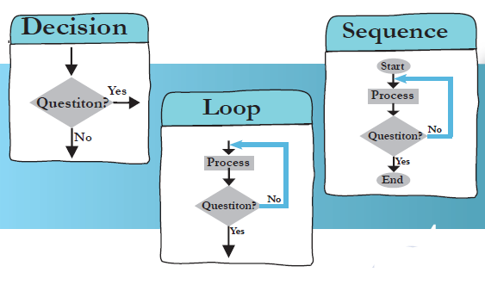
DESIGNING ALGORITHM
A process or set of rules to be followed in calculations or other problem-solving operations
What is a flowchart?
• A flowchart is a picture (graphical representation) of the problem solving process.
• A flowchart gives a step-by-step procedure for solution of a problem
Drawing a flowchart,
• Identify input and output.
• Apply reasoning skills to solve the problem.
• Draw the flowchart using the appropriate symbols and arrows to show the Guidelines sequence of steps in solving the problem.

Slide 5
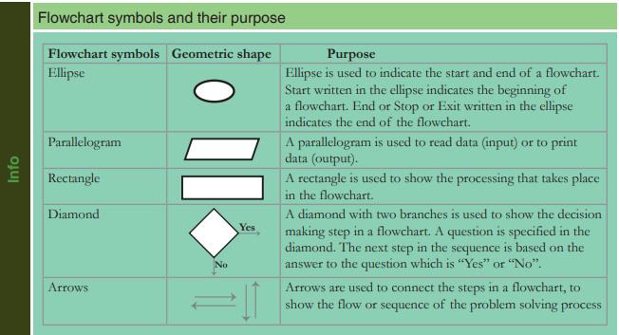
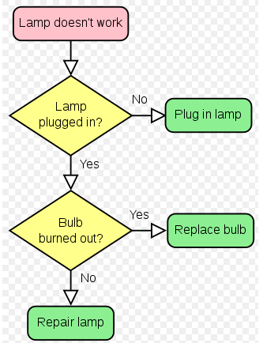
FLOWCHART

Slide 6
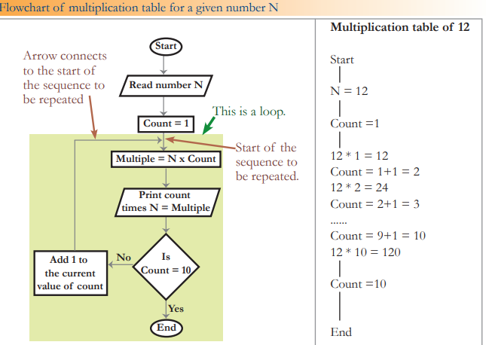
FLOWCHART

Slide 7
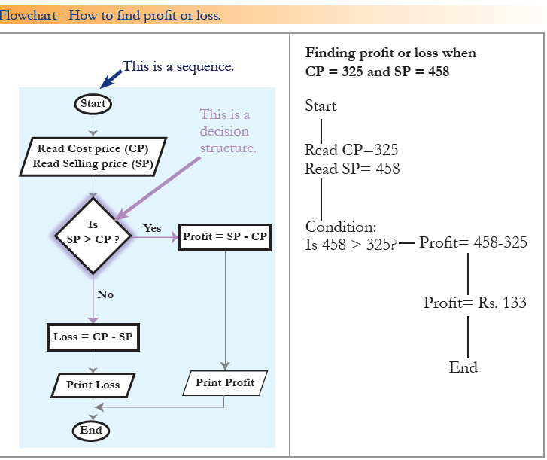
FLOWCHART

Slide 8
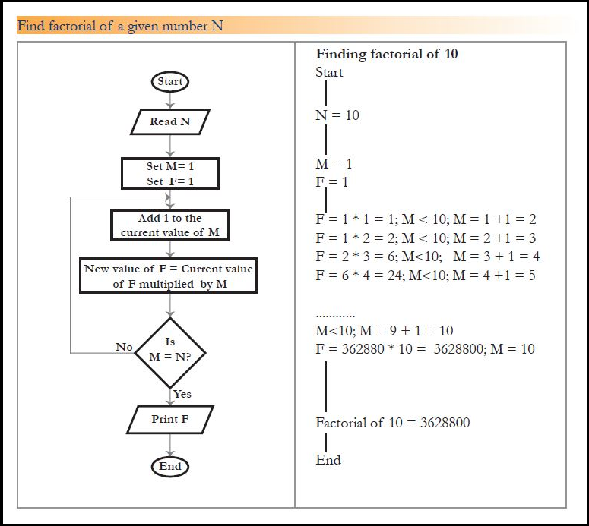
FLOWCHART

Slide 9
Data structure approach
Structured design is a conceptualization of problem into several well-organized elements of solution. It is basically concerned with the solution design. Benefit of structured design is, it gives better understanding of how the problem is being solved. Structured design also makes it simpler for designer to concentrate on the problem more accurately.
A good structured design always follows some rules for communication among multiple modules, namely -
Cohesion - grouping of all functionally related elements.
Coupling - communication between different modules.
A good structured design has high cohesion and low coupling arrangements.

Slide 10
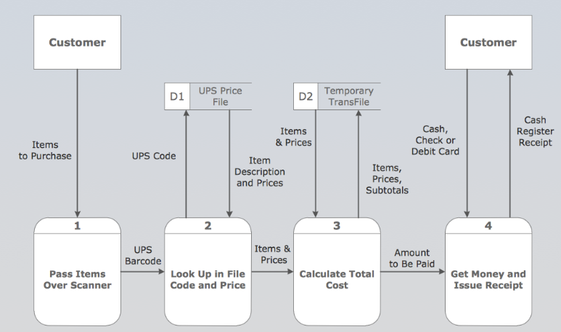
Structured desıgn

Slide 11
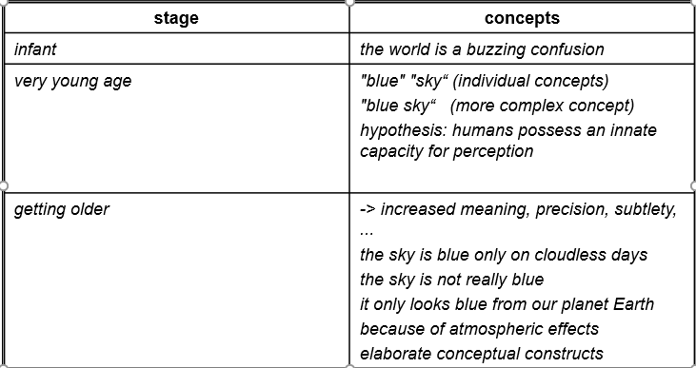
WHY OBJECT ORIENTED
“The "software crises" came about when people realized the major problems in software development were … caused by communication difficulties and the management of complexity”
Concept formation: from chaos to order!

Slide 12


WHAT IS object?
An "object" is anything to which a concept applies, in our awareness
Things drawn from the problem domain or solution space.
E.g., a living person in the problem domain, a software component in the solution space.

Slide 13
Thinking About Objects
Objects
Reusable software components that model real-world items
Look all around you
People, animals, plants, cars, etc.
Attributes
Size, shape, color, weight, etc.
Behaviors
Babies cry, crawl, sleep, etc.

Slide 14
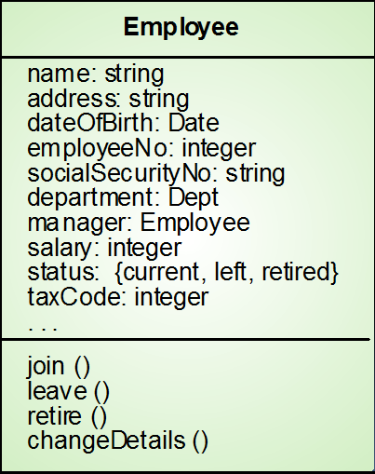
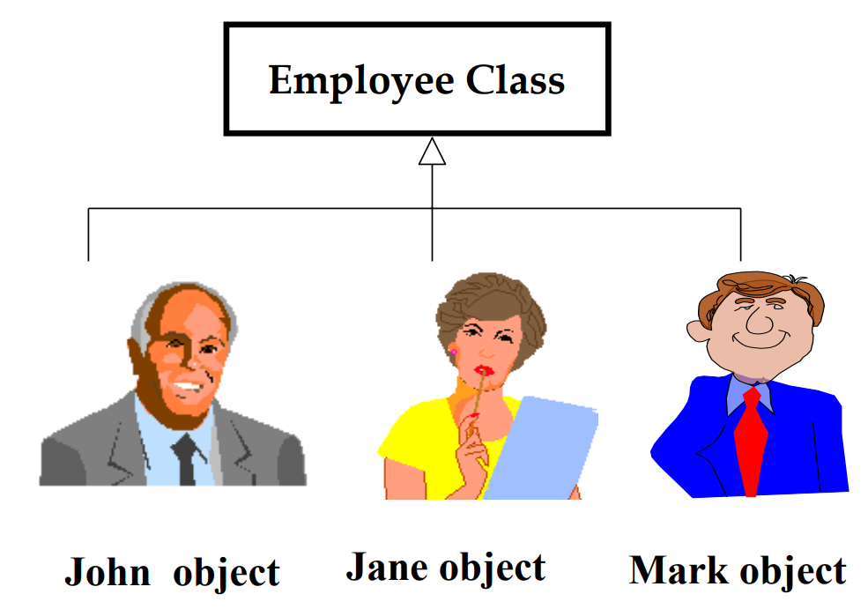
WHAT IS CLASS?
Object classes are templates for objects. They may be used to create objects
Object classes may inherit attributes and services from other object classes

Slide 15
Object-Oriented Style
Programming with Abstract Data Types
ADTs specify/describe behaviors.
Has an Basic Program Unit: Class
Implementation of an ADT.
Abstraction enforced by encapsulation.
Basic Run-time Unit: Object
Instance of a class.
associated state.

Slide 16
Object-Oriented Concepts
Data Abstraction (specifies behavior)
Encapsulation (controls visibility of names)
Polymorphism (accommodates various implementations)
Inheritance (facilitates code reuse)
Modularity (relates to unit of compilation)

Slide 17
More about ood
Object-oriented design (OOD)
Models real-world objects
Models communication among objects
Encapsulates data (attributes) and functions (behaviors)
Information hiding
Communication through well-defined interfaces
Object-oriented language
Programming is called object-oriented programming (OOP)
Java

Slide 18
the Unified Modeling Language
Unified Modeling Language (UML)
Graphical language that uses common notation
Allows developers to represent object-oriented designs
UML Diagrams
Use Case Diagrams
Class Diagrams
Package Diagrams
Sequence Diagrams
Interaction Diagrams
Sequence
Colloboration
Activity Diagrams
State Transition Diagrams
Deployment Diagrams

Slide 19
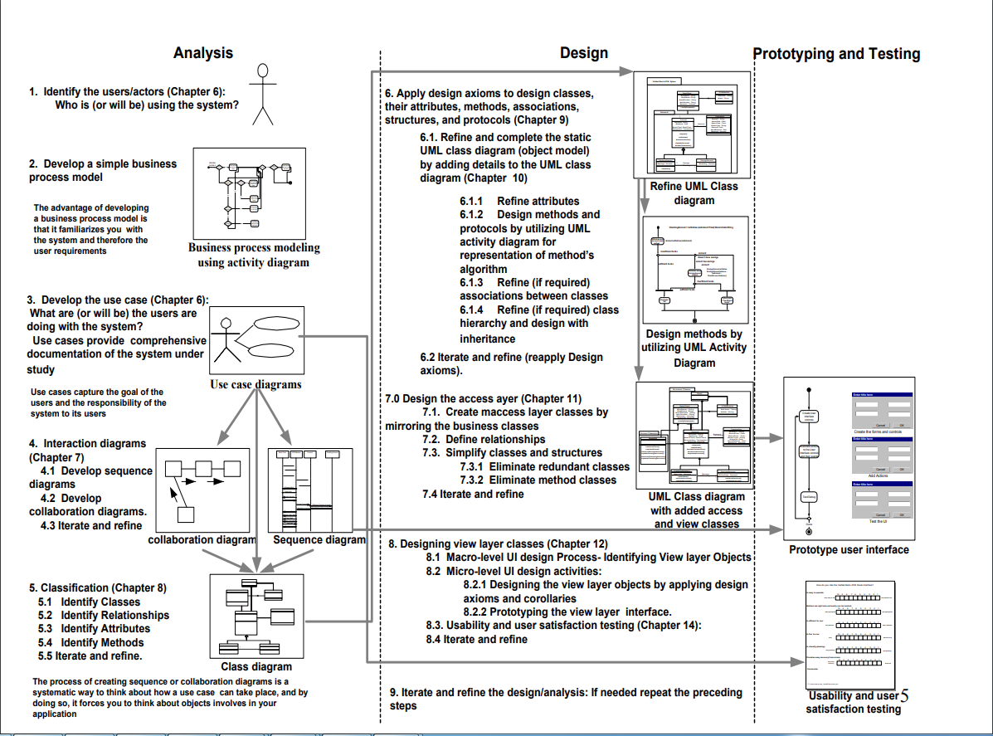

Slide 20
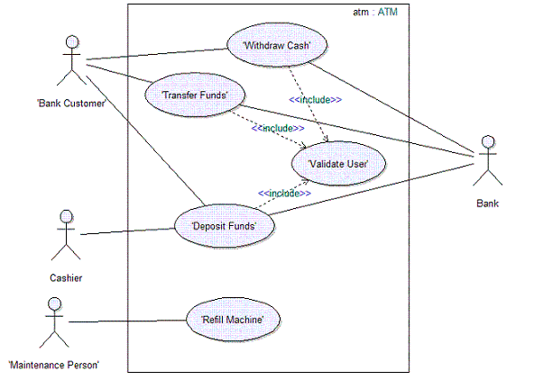
USE CASE DIAGRAM
<<extend>> is used when a use case adds steps to another first-class use case.
<<include>> is used to extract use case fragments that are duplicated in multiple use cases.
The included use case cannot stand alone and the original use case is not complete without the included one

Slide 21
A Case Study - A Payroll Program
Consider a payroll program that processes employee records at a small manufacturing firm. This company has three types of employees:
1. Managers: Receive a regular salary. •
2. Office Workers: Receive an hourly wage and are eligible for overtime after 40 hours.
3. Production Workers: Are paid according to a piece rate

Slide 22
Structured Approach
FOR EVERY EMPLOYEE DO
BEGIN
IF employee = manager THEN
CALL computeManagerSalary
IF employee = office worker THEN
CALL computeOfficeWorkerSalary
IF employee = production worker THEN
CALL computeProductionWorkerSalary
END

Slide 23
What if we add two new types of employees?
Temporary office workers ineligible for overtime,
Junior production workers who receive an hourly wage plus a lower piece rate.

Slide 24
Structured Approach
FOR EVERY EMPLOYEE DO
BEGIN
IF employee = manager THEN
CALL computeManagerSalary
IF employee = office worker THEN
CALL computeOfficeWorkerSalary
IF employee = production worker THEN
CALL computeProductionWorkerSalary
IF employee = temporary office worker THEN
CALL computeTemporaryOfficeWorkerSalary
IF employee = junior production worker THEN
CALL computeJuniorProductionWorkerSalary
END

Slide 25
An Object-OrIented Approach
The goal of OO analysis is to identify objects and classes that support the problem domain and system's requirements.
Some of application’s classes
Employee
Manager
Office Workers
Production Workers

Slide 26
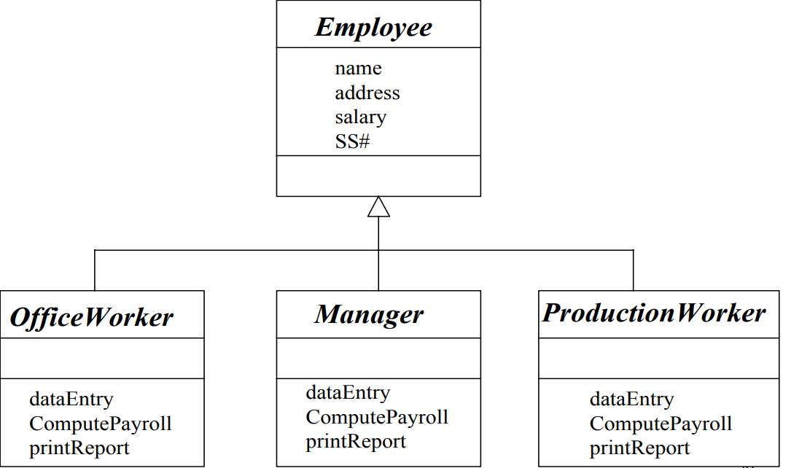
Class HIERARCHY

Slide 27
OO APPROACH
FOR EVERY EMPLOYEE DO
BEGIN
employee computePayroll
END

Slide 28
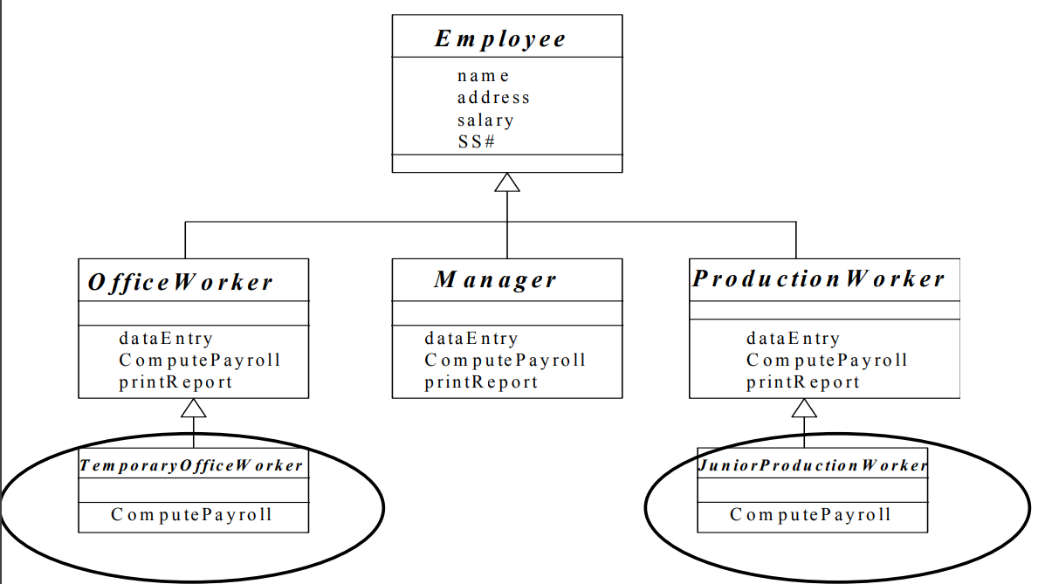
If new types of employees were added…

Slide 29
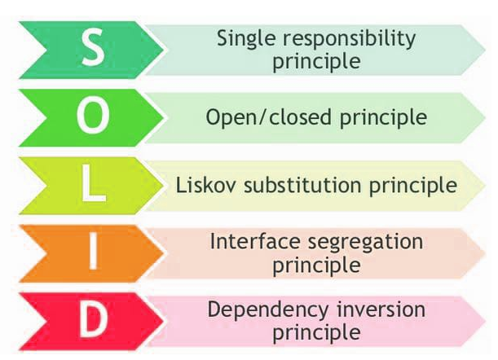
Object Orıented desıgn prıncıples
❑ Manage complexity of a system
❑ Improve software quality factors
❑ Manage changes easily with minimum cost
❑ Facilitate reusability

Slide 30
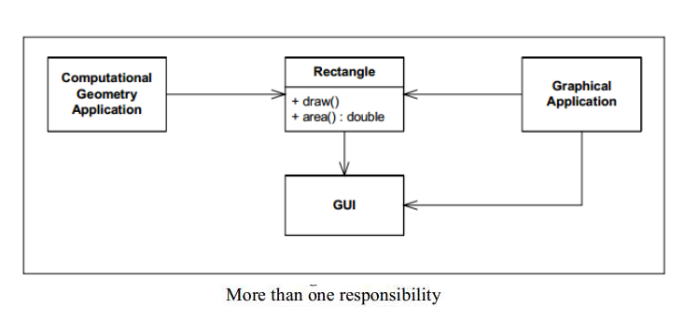
Single Responsibility Principle (SRP)
There should never be more than one reason for a class to change.

Slide 31
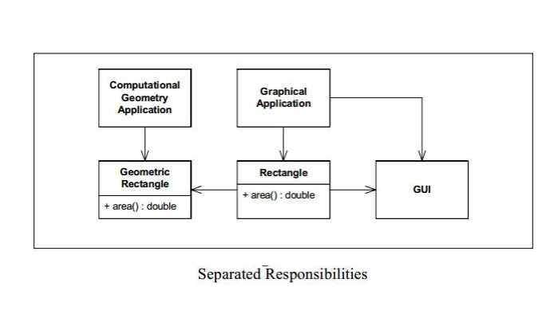
Single Responsibility Principle (SRP)

Slide 32
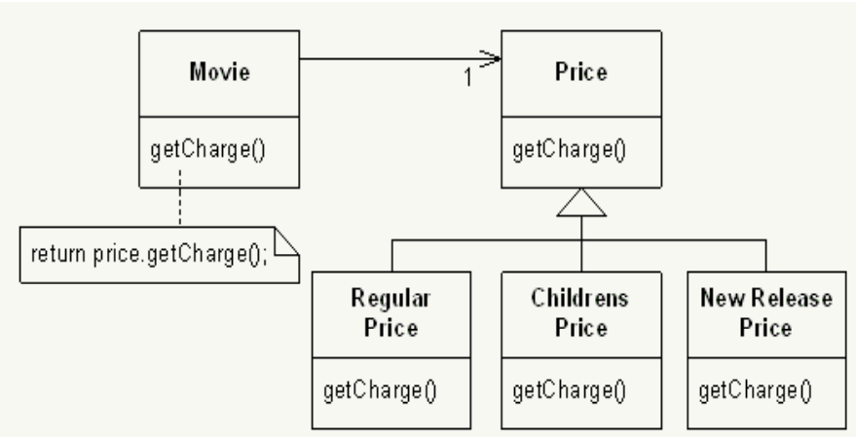
Open/closed prıncıple (Ocp)
A module should be open for extension but closed for modification

Slide 33
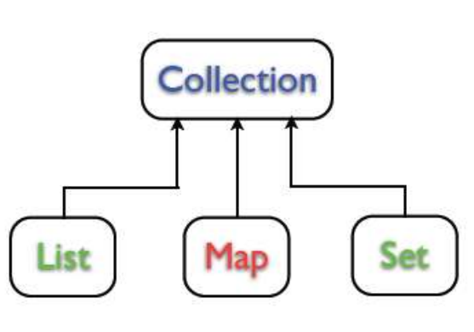
Liskov Substitution Principle (LSP)
Subclasses should be substitutable for their base classes.

Slide 34
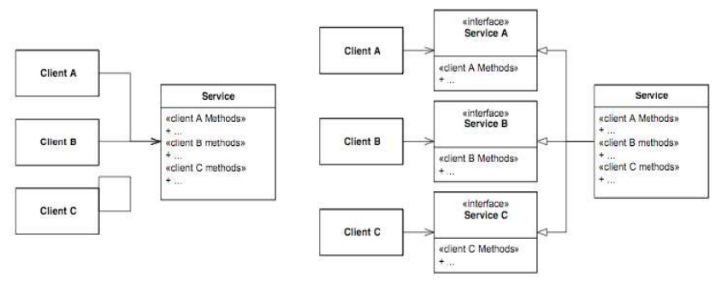
Interface Segregation Principle (ISP)
Many client specific interfaces are better than one general purpose interface.

Slide 35
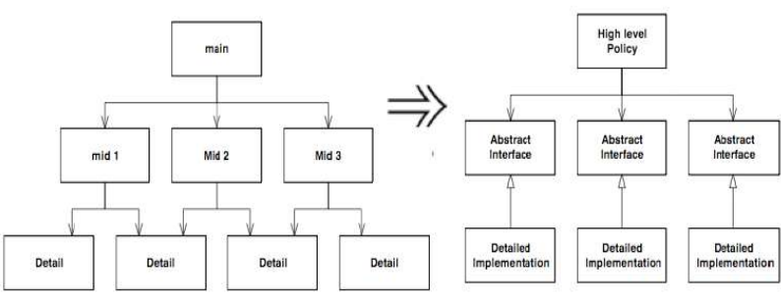
Dependency Inversion Principle (DIP)
Depend upon Abstractions. Do not depend upon concretions

Slide 36
DRY – Don’t Repeat yourself
The Don’t Repeat Yourself (DRY) principle states that duplication in logic should be eliminated via abstraction; duplication in process should be eliminated via automation.
Duplication is Waste Adding additional, unnecessary code to a codebase increases the amount of work required to extend and maintain the software in the future. Duplicate code adds to technical debt.

Slide 37
LAB STUDY
11.02.2020
Download Java SE
Download Java Editor – Eclipse or Intellij
Develop Hello World Aplication and run at console
Run Hello World Aplication at editor

Slide 38

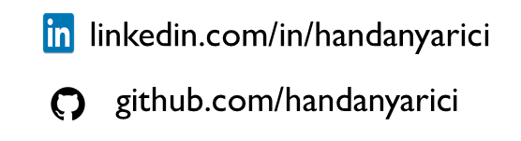
tHANKS!
handanyarici@gmail.com

